Slide 1
Internal Details of Java program
Presented by S.R.Zameer

Slide 2
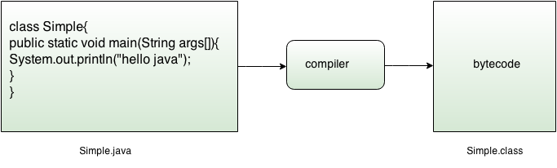
What happens at compile time?
At compile time, java file is compiled by Java Compiler (It does not interact with OS) and converts the java code into bytecode.

Slide 3
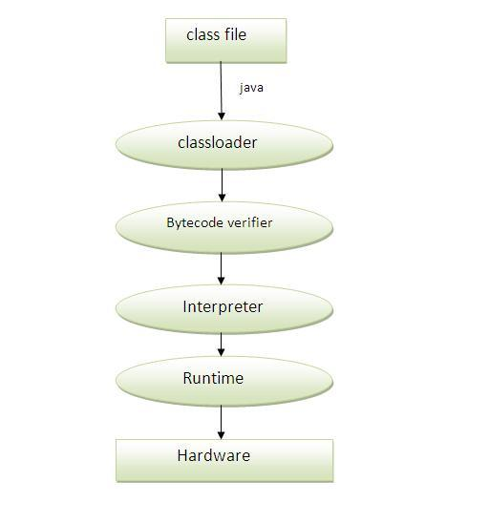
What happens at runtime?

Slide 4
Classloader, Bytecode Verifier and Interpreter
Classloader: is the subsystem of JVM that is used to load class files.
Bytecode Verifier: checks the code fragments for illegal code that can violate access right to objects.
Interpreter: read Bytecode stream then execute the instructions.

